Slide 1
Java Conditional/Control Statements Examples, Java Conditional/Control Loops, Jump Statements, and Examples.
- SAYALI YADAV

Slide 2
Java Conditional/Control Statements
Java compiler executes the code from top to bottom. The statements in the code are executed according to the order in which they appear. However, Java provides statements that can be used to control the flow of Java code. Such statements are called control flow statements. It is one of the fundamental features of Java, which provides a smooth flow of program.
Java provides three types of control flow statements.
Decision Making statements
Loop statements
Jump statements

Slide 3
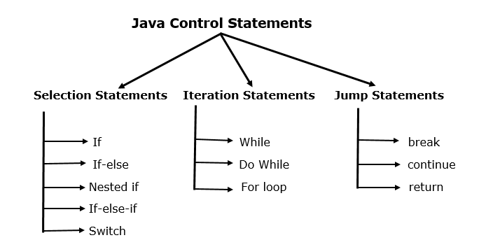
Control Flow Statements

Slide 4
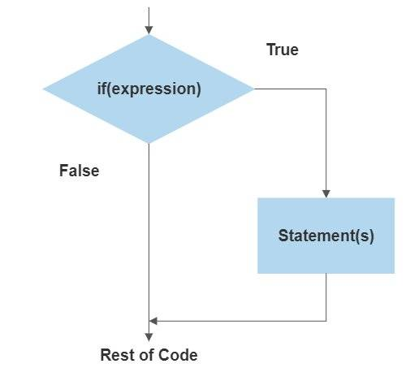
DECISION MAKING STATEMENTS
Decision-making statements in Java are constructs used to control the flow of execution based on certain conditions. They allow a program to execute different parts of code depending on whether a condition (or set of conditions) is true or false. The decision-making statements in Java are primarily of 3 types, namely: if, if-else and switch statements.
1) 'if' Statement in Java
The if statement in Java evaluates a boolean condition. If the condition is true, the block of code inside the if statement is executed. It's the simplest form of decision-making in programming, allowing for the execution of certain code based on a condition.
Syntax:
if (condition)
{ // Code to execute if the condition is true
}

Slide 5
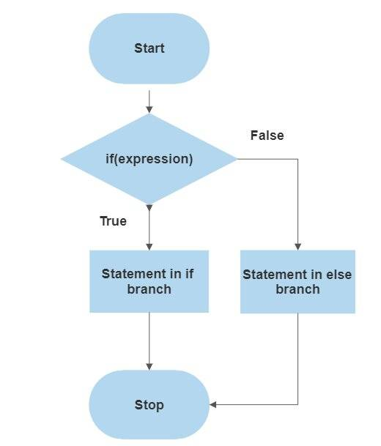
DECISION MAKING STATEMENTS
2) 'if-else' Statement in Java
The if-else statement in Java is used for multiple conditions. It comes after an if statement and before an else statement. If the if condition is false, the program checks the if-else condition. If the if-else condition is true, its code block is executed.
Syntax
if (condition) { // Code to execute if the condition is true } else { // Code to execute if the condition is false }

Slide 6
EXAMPLES OF IF & IF-ELSE
Example of if statement
int age = 18;
if (age >= 18)
{
System.out.println ("You are an adult.");
}
Example of if – else statement
int score = 65 ;
if (score >= 50)
{
System.out.println ("You passed the exam.");
}
else
{
System.out.println ("You failed the exam.") ;
}

Slide 7
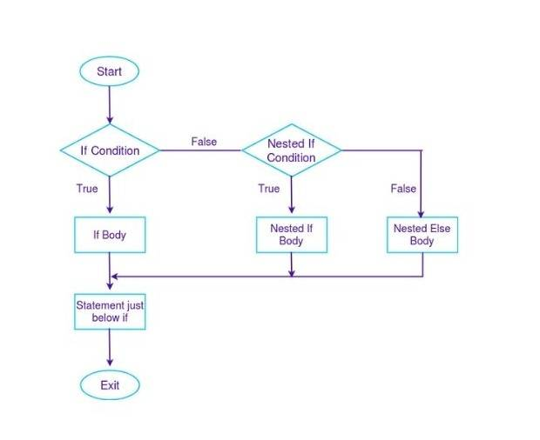
DECISION MAKING STATEMENTS
3) Nested 'if-else' Statement in Java.
In Java, a nested if-else statement is when you have an if-else block inside another if or else block. It's like placing one decision within another decision. You use this when you want to check for a new condition after a previous condition has already been found true (or false).
if (condition1) {
// Statements to execute if condition1 is true
if (condition2) {
// Statements to execute if condition1 and condition2 are both true
} else {
// Statements to execute if condition1 is true and condition2 is false
} else {
// Statements to execute if condition1 is false
}
}

Slide 8
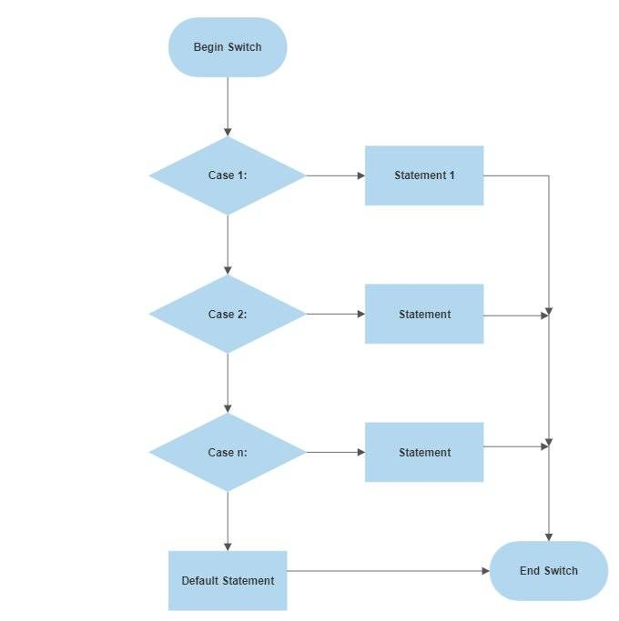
DECISION MAKING STATEMENTS
4)'switch' Statement in Java
The switch statement in Java allows for the selection of a block of code to be executed based on the value of a variable or expression. It is an alternative to a series of if statements and is often more concise and easier to read.
switch (expression) { case value1: // Code to be executed if expression equals value1 break; case value2: // Code to be executed if expression equals value2 break; // ... default: // Code to be executed if expression does not match any case }

Slide 9
EXAMPLES OF NESTED IF-ELSE & SWITCH
Example of nested if – else statement
Example of is switch statement
int day = 3;
switch (day)
{
case 1:
System.out.println("Monday");
break;
case 2:
System.out.println("Tuesday");
break;
case 3:
System.out.println("Wednesday");
break;
case 4:
System.out.println("Thursday");
break;
case 5:
System.out.println("Friday");
break;
case 6:
System.out.println("Saturday");
break;
case 7:
System.out.println("Sunday");
break;
default:
System.out.println("Invalid day"); break;
}
int marks = 85;
if (marks >= 90)
{
System.out.println("Grade A");
}
else if (marks >= 75)
{
System.out.println("Grade B");
}
else if (marks >= 50)
{
System.out.println("Grade C");
}
else {
System.out.println("Fail");
}

Slide 10
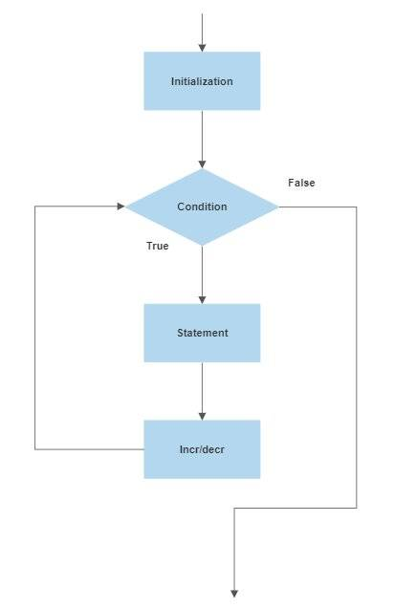
Looping Statements In Java
Looping statements in Java are used to execute a block of code repeatedly based on a given condition or set of conditions. These statements are fundamental to Java programming, allowing for iteration over data structures, repetitive tasks, and more. The main types of looping statements in Java are for loop, while loop and do-while loop.
1) 'for loop' in Java
The for loop in Java is a control structure that allows repeated execution of a block of code for
a specific number of times. It is typically used when the number of iterations is known beforehand.
for (initialization; condition; update) { // code block to be executed }
Initialization: Typically used to initialize a counter variable.
Condition: The loop runs as long as this condition is true.
Update: Updates the counter variable, usually incrementing or decrementing.

Slide 11
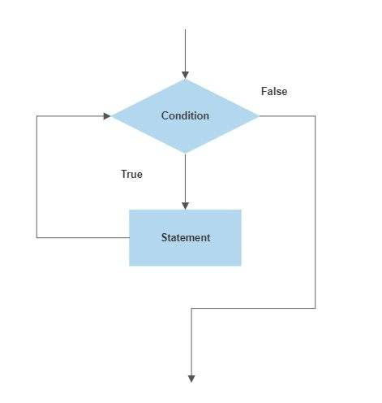
Looping Statements In Java
2) 'while loop' in Java
A while loop in Java repeatedly executes a block of code as long as a specified condition remains true. It is ideal for situations where the number of iterations is not predetermined.
Syntax
while (condition) { // code block to be executed }
Condition: The loop continues to run as long as this condition evaluates to true.
Code Block: The statements inside the loop execute repeatedly until the condition becomes false.

Slide 12
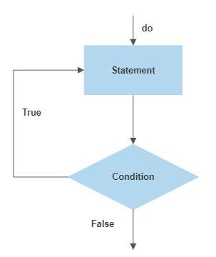
Looping Statements In Java
3)’do-while loop' in Java
The do-while loop in Java is a post-tested loop, meaning it executes the body of the loop at least once before checking the condition. This loop is useful when you need to ensure that the loop body is executed at least once, regardless of whether the condition is true or false. After the body of the loop has executed, the condition is tested. If the condition is true, the loop will execute again. This process repeats until the condition becomes false.
do { // Statements to execute } while (condition);
do: This keyword starts the do-while loop.
Statements to execute: These are the actions you want to perform. This block of code is executed on each iteration of the loop, and it is guaranteed to run at least once.
while: This keyword is followed by a condition in parentheses.
condition: A Boolean expression that is evaluated after the loop body has executed. If this condition evaluates to true, the loop will execute again. If it evaluates to false, the loop will terminate, and control passes to the statement immediately following the loop.

Slide 13
Looping Statements In Java
4) Java For-each Loop
The Java for-each loop or enhanced for loop is introduced since J2SE 5.0. It provides an alternative approach to traverse the array or collection in Java. It is mainly used to traverse the array or collection elements.
for(data_type variable : array | collection)
{
//body of for-each loop
}
Example:
int arr[]={12,13,14,44};
for(int i:arr){
System.out.println(i);
}

Slide 14
Example of while loop
int i = 1;
while (i <= 5)
{
System.out.println("Number: " + i);
i++;
}
Example of do –while loop
int i = 1;
Do
{
System.out.println("Number: " + i);
i++;
} while (i <= 5);
Example of for loop
for (int i = 1; i <= 5; i++)
{
System.out.println("Number: " + i);
}

Slide 15
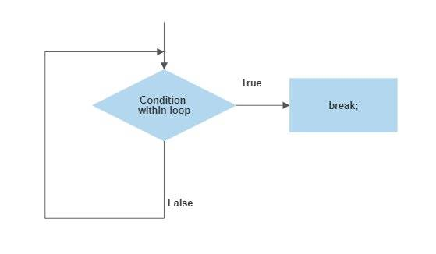
Jump Statements
Jump Statements
Jump statements in Java are used to transfer control to another part of the program. They are particularly useful for breaking out of loops or skipping to the next iteration of a loop. The three main types of jump statements are break, continue, and return. Each serves a different purpose in controlling the flow of execution.
1) 'break' Statement in Java
The break statement is used to exit from a loop (for, while, do-while) or a switch statement.
When encountered, it terminates the loop or switch statement and transfers
control to the statement immediately following the loop or switch.
Syntax
break;

Slide 16
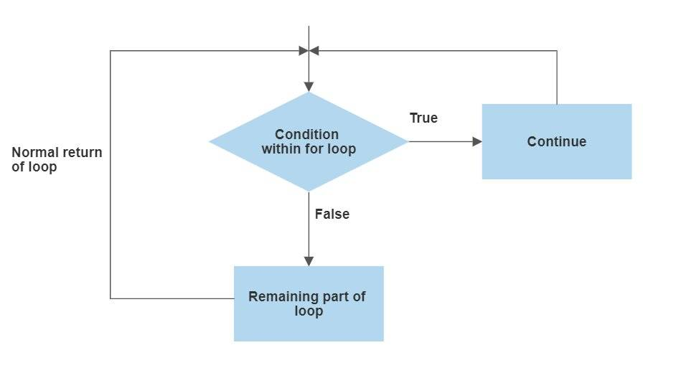
Jump Statements
2) 'continue' Statement in Java
The continue statement skips the current iteration of a loop (for, while, do-while) and proceeds to the next iteration. It effectively jumps to the end of the loop's body and re-evaluates the loop's condition.
Syntax
Continue;

Slide 17
Examples Of Jumping Statement
Examples of return statement
public class Main {
public static void main(String[] args) {
int result = addNumbers(5, 10);
System.out.println("Result: " + result);
}
public static int addNumbers(int a, int b)
{
return a + b; // return the sum of a and b
}
}
Examples of break statement
for (int i = 1; i <= 5; i++)
{ if (i == 3)
{
break;
}
System.out.println("Number: " + i);
}
Examples of continue statement
for (int i = 1; i <= 5; i++)
{
if (i == 3)
{
continue;
}
System.out.println("Number: " + i);
}

Slide 18
Jump Statements
3) 'return' Statement in Java
The return statement is used to exit from a method, with or without a value. For methods that return a value, return specifies the value to return. For void methods, it causes the method to exit before reaching the end of its body.
Syntax
Syntax for Methods Returning a Value
return expression;
expression: This must evaluate to a value that is compatible with the method's declared return type. If the method is supposed to return an int, for example, the expression must evaluate to an integer value.
Syntax for Void Methods
return;

